Slide 1
Dimensionality Expansion
Kernel Trick
WKSP 320 Module 1, Lesson 2
Notes:
Welcome to this lesson on Dimensionality Expansion. This is kind of like the inverse of our last lection on Dimensionality Reduction.
Why might you need Dimensionality Expansion? When your data as you have is not sufficient to separate classes or make an estimation with the desired level of accuracy.
Sometimes you’ll see that even using an advanced algorithm and tuning all hyper-parameters will not lead to much improved accuracy. Then you need to start looking into either finding more data or mathematically expanding the variables you have to see if that would lead to better results.

Slide 2
Combining Data
Notes:
First let’s talk about finding alternative datasets and combining them. We covered this in workshop 220, but this is a good time for a refresher.

Slide 3
Fitbit Activity Table
Activity Date | Total Steps | Total Distance
4/12/2016 | 13162 | 8.5
4/13/2016 | 10735 | 6.97
Notes:
So let's see an example of combining data. Here's a table from collection of Fitbit data you can find on the website Kaggle.com
This table has information on the number of steps and estimated distance travelled by users on particular days

Slide 4
Fitbit Sleep Table
Sleep Day | Total Sleep Records | Total Minutes Asleep | Total Time In Bed
4/12/2016 0:00 | 1 | 327 | 346
4/13/2016 0:00 | 2 | 384 | 407
Notes:
This table is shows the sleep data of users.

Slide 5
Normalize Format
Activity Date | Total Steps | Total Distance
4/12/2016 | 13162 | 8.5
4/13/2016 | 10735 | 6.97
Sleep Day | Total Sleep Records | Total Minutes Asleep | Total Time In Bed
4/12/2016 0:00 | 1 | 327 | 346
4/13/2016 0:00 | 2 | 384 | 407
Notes:
If you want to combine tables, you need to do it using a common column. Here, that could be the Date. But there's something different between the two.
What is it (one has date and time)

Slide 6
Normalize Format
Activity Date | Total Steps | Total Distance
4/12/2016 | 13162 | 8.5
4/13/2016 | 10735 | 6.97
Sleep Day | Total Sleep Records | Total Minutes Asleep | Total Time In Bed
4/12/2016 0:00 | 1 | 327 | 346
4/13/2016 0:00 | 2 | 384 | 407
table_sleep[‘SleepDay’].str.split()
Notes:
We need to split off the time – then the column format will match and you can combine the tables.

Slide 7
Normalize Format
Activity Date | Total Steps | Total Distance
4/12/2016 | 13162 | 8.5
4/13/2016 | 10735 | 6.97
Sleep Day | Time | Total Sleep Records | Total Minutes Asleep | Total Time In Bed
4/12/2016 | 0:00 | 1 | 327 | 346
4/13/2016 | 0:00 | 2 | 384 | 407
Notes:
So now each column has exactly the same format and can be used as a key (in database language) to combine these two datasets.

Slide 8
Join Table
Sleep Day | Time | Total Sleep Records | Total Minutes Asleep | Total Time In Bed | Total Steps | Total Distance
4/12/2016 | 0:00 | 1 | 327 | 346 | 13162 | 8.5
4/13/2016 | 0:00 | 2 | 384 | 407 | 10735 | 6.97
table_joined = pd.merge(Sleep, Activity, on=“SleepDay”)
Notes:
When you combine the tables, now you can run queries that look for patterns in number of steps and sleep outcomes.

Slide 9
One-Hot Encoding
Notes:
One thing that you’ll find is that most Python algorithms don’t natively accept non-numerical data.
So if you have labelled data, you can either have nominal or ordinal. If you have ordinal, such as big, bigger, biggest, replace these with numbers like 0,1,2.
But if you have nominal data where there is no order to the labels, like a car color being red, yellow, green, you can use One-hot state encoding to turn them into numbers and use that data for your algorithm.

Slide 10

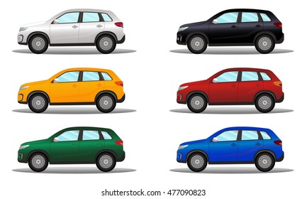
Ordinal
Nominal
0
1
2

Slide 11
Categorical Data
Salutation
Mr.
Ms.
Mrs.
Master
Mr. | Ms. | Mrs. | Master
1 | 0 | 0 | 0
0 | 1 | 0 | 0
0 | 0 | 1 | 0
0 | 0 | 0 | 1
Notes:
So here, in the titanic dataset we processed in workshop 220, we replace the salutation column with one new column for each salutation type. For example for the salutation of Mr, you create a new column for Mr, and the value for an observation is 1 if originally that passenger’s salutation as Mr, and 0 otherwise. So you’ve expanded the number of columns from 1 labelled column to 4 in this case, one for each label.

Slide 12
The Kernel Trick
Notes:
Next up let’s talk about mathematical transformations. Sometimes you’ll find that the classes are not separable in the data given the variables that you have. But you might find that transforming these variables into more dimensions makes classifying easier.

Slide 13
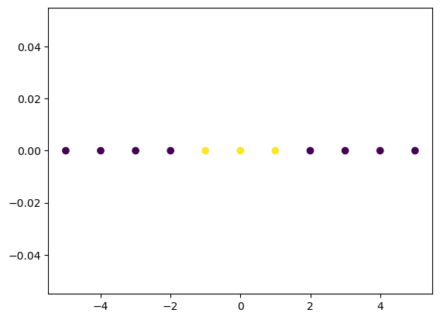
Linearly Inseparable
Notes:
Sometimes you get data that is linearly inseparable, or not separable in an easy way from just the data that you have. Shown here are 2 classes with the yellow class sitting right between the two groups of black. In it’s current form, it’s a 1-dimensional array.

Slide 14
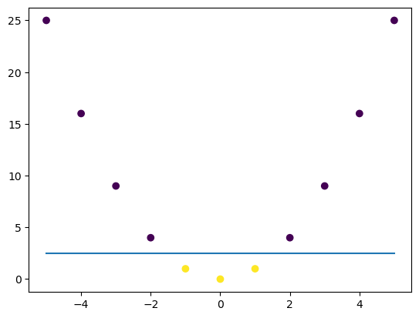
Quadratic Transformation
Notes:
If you were to square the original values and then represent the data in 2 dimensions, you can now easily separate the data through a linear line.
So you’ve increased the number of dimensions from 1 to 2, but made the classification problem much easier.

Slide 15
Many Transformation Functions
Polynomial kernel
Gaussian Kernel or Radial Basis Function
Sigmoid Kernel
Computationally very intensive to transform all data to these higher dimensions
Notes:
There are many different kernels to choose from. We won’t go over how they are mathematically represented. Polynomial kernels can expand the number of dimensions based on the power of the polynomial you choose.
Gaussian or Radian Basis Functions, termed “RBF” kernels can transform your data into infinite dimensional space.
Using complex kernels for transformation quickly becomes computationally challenging. So we use the Kernel trick to separate the data in the original dimensions without needing to go into the higher dimensions.

Slide 16
Kernel Trick
Notes:
Originally, we took our 1 dimensional data, calculated another dimension we squared it, drew a new separation line, and then we can bring the data back to the original 1 dimension, we see that the linear separator turns into a curved line.
The middle step of calculating higher dimensions and bringing the data back to the original dimensions is where a lot of computational resources are used. Think about if you boosted this to 20 or 30 dimensions. This would take a long time and you’re not guaranteed better results.

Slide 17
Kernel Trick
Notes:
The Kernel trick removes the need for the middle step. It calculates a decision boundary in the original dimensions.

Slide 18

Kernel Trick
Transform data in the original dimensional space
No need to calculate every new dimension
Polynomial Kernel:
$$k\left(x_{i},x_{j}\right)={\left(1+x_{i}^{T}x_{j}\right)}^{2}$$
RBF Kernel: $k\left(x_{i},x_{j}\right)=exp\left(\frac{{\left|\left|x_{i}−x_{j}\right|\right|}^{2}}{2σ^{2}}\right)$
Kernel Function
Original Data Dimensions (i,j)
Notes:
With the Kernel trick, you get the transformed data without having to jump to the higher dimensions using kernel functions. In this example, we use the polynomial function k() for a 2nd order polynomial.
We can compute the locations of the transformed data using the inner product of the 2 dimensions which is very computationally efficient. Also, these are easy to use in Python and we’ll practice using them.
The math and most of the concepts are outside the scope of this class. But I’m including 2 good YouTube videos on this page in Canvas and in the notes section of this slide if you want to learn more.
Short explanation with Python: https://youtu.be/Q7vT0--5VII
Longer lecture with theory: Lecture 15 - Kernel Methods - YouTube

Slide 19
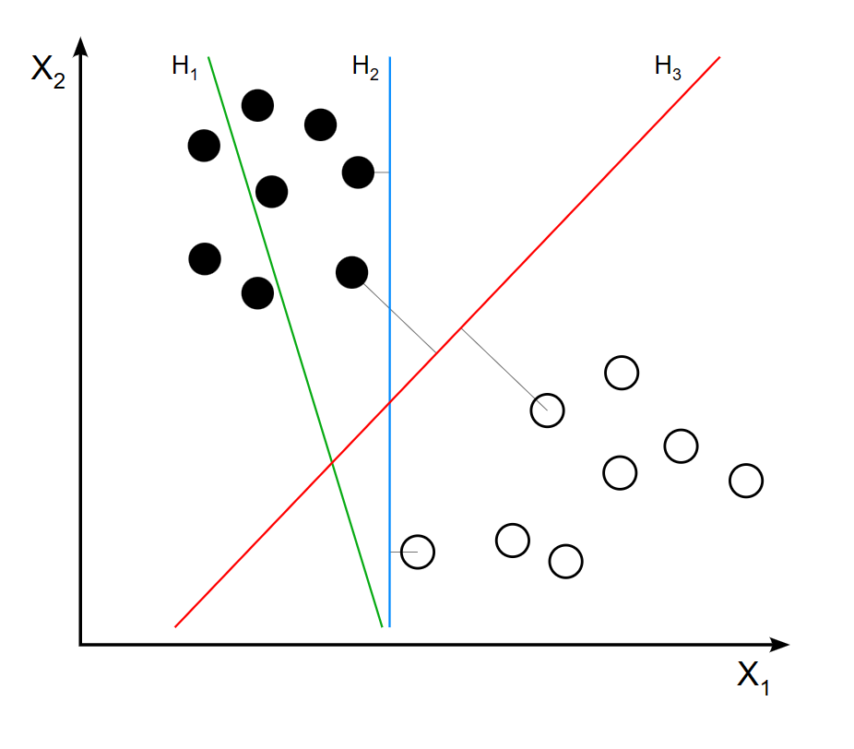
Support Vector Machines
Notes:
Support Vector Machines are linear classifiers that attempt to find the best linear split of 2 classes by maximizing the margin between the two groups. We will not be covering the math and theory behind this classifier, but we will use it to explore the Kernel Trick.
Image By User:ZackWeinberg, based on PNG version by User:Cyc - This file was derived from: Svm separating hyperplanes.png, CC BY-SA 3.0, https://commons.wikimedia.org/w/index.php?curid=22877598

